Slide 1
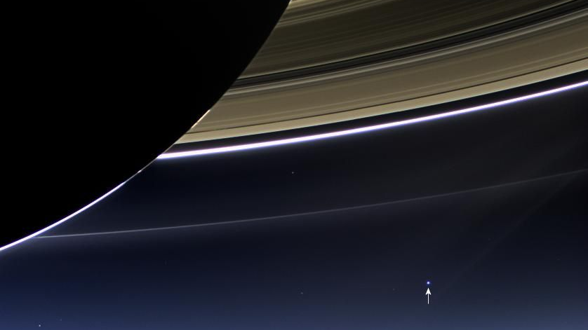
Pale Blue Dot
Astronomy for Global Citizenship and Environmental Awareness

Slide 2
After one year of looking at one hundred years of milestones in astronomy, let’s look back at Earth and how astronomy shows us the place of our home planet in the universe and can help us address global challenges.
Notes:
This event will close off the IAU100 celebrations

Slide 3
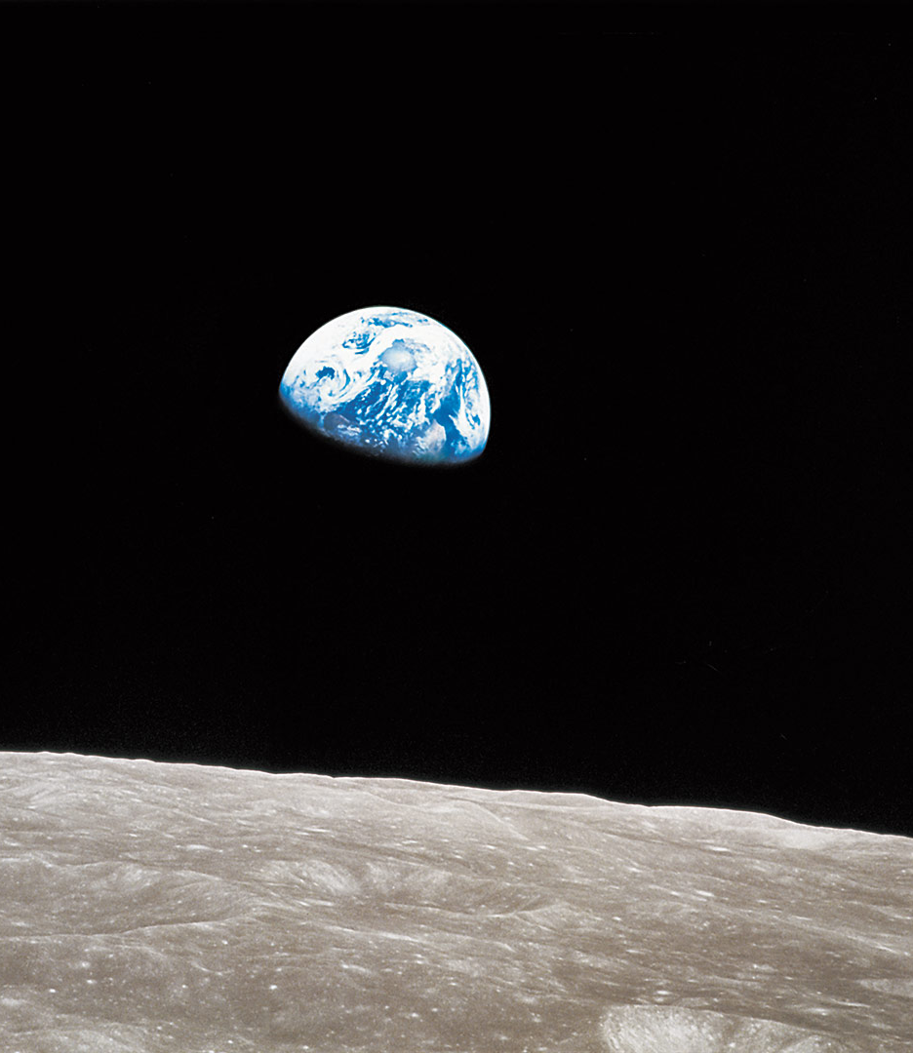
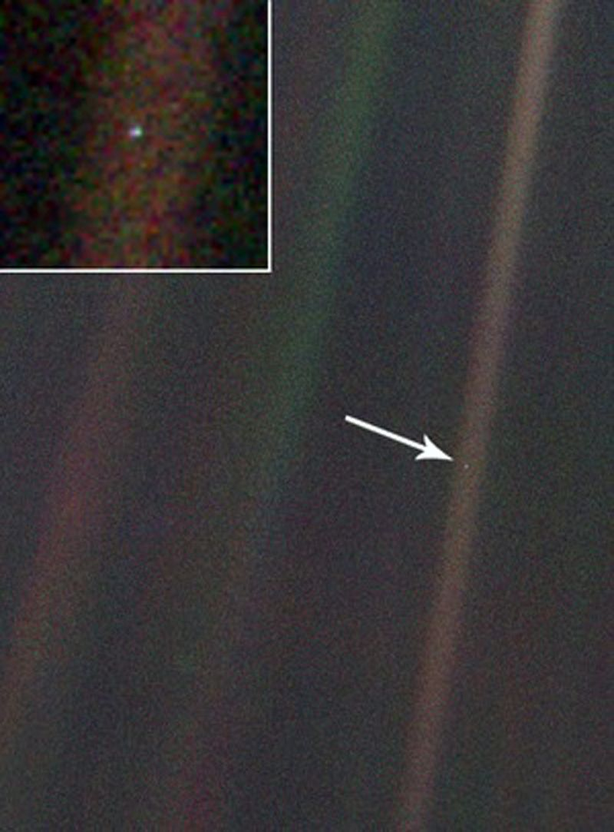
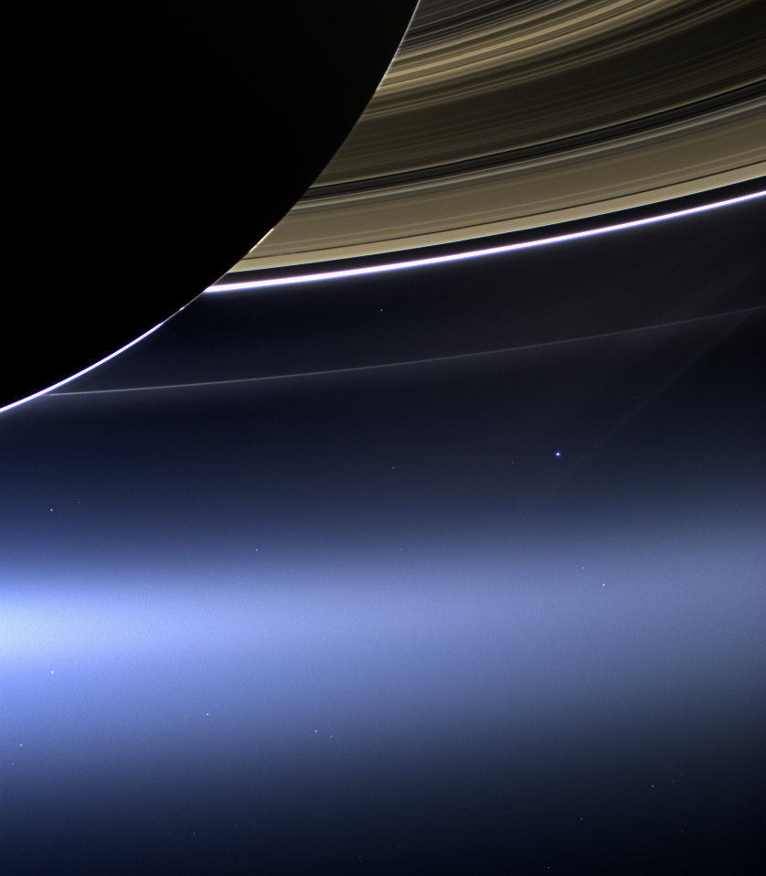
Photos of our home planet from space have impacted humanity, they instigated climate change movements and inspire people from all over the world.
Apollo 8
Earthrise
December 24, 1968
Voyager-1
Pale Blue Dot February 14, 1990
Cassini-Huygens
The Day the Earth Smiled
July 19, 2013
Notes:
Photos of Earth from space had great impact on humanity: they spurred environmental movements and united and inspired people around the globe. The Earthrise photo was declared "the most influential environmental photograph ever taken" by nature photographer Galen Rowell. The photo was not really planned for the mission, but became a famous legacy.

Slide 4
“Look again at that dot. That's here. That's home. That's us. On it everyone you love, everyone you know, everyone you ever heard of, every human being who ever was, lived out their lives.
It has been said that astronomy is a humbling and character-building experience. There is perhaps no better demonstration of the folly of human conceits than this distant image of our tiny world. To me, it underscores our responsibility to deal more kindly with one another, and to preserve and cherish the pale blue dot, the only home we've ever known.”
- Carl Sagan
Notes:
Carl Sagan was the astronomer who requested that the Voyager-1 space probe, after completing its mission, would look back at the Earth before leaving the solar system and make a photo. Earth is visible as less than one pixel, a tiny blue dot in a vastness of space. The photo is not scientifically valuable, but very meaningful to mankind. Carl Sagan wrote a book about his reflections on this photo and its meaning, also called “Pale Blue Dot: A Vision of the Human Future in Space”

Slide 5
The Pale Blue Dot message:
Astronomy for peace and solidarity
The astronomical perspective shows us that there are no actual national borders: we are one humanity, under one sky.
We are all global citizens of planet Earth. We should therefore be open minded to other cultures and show solidarity to live together peacefully.

Slide 6
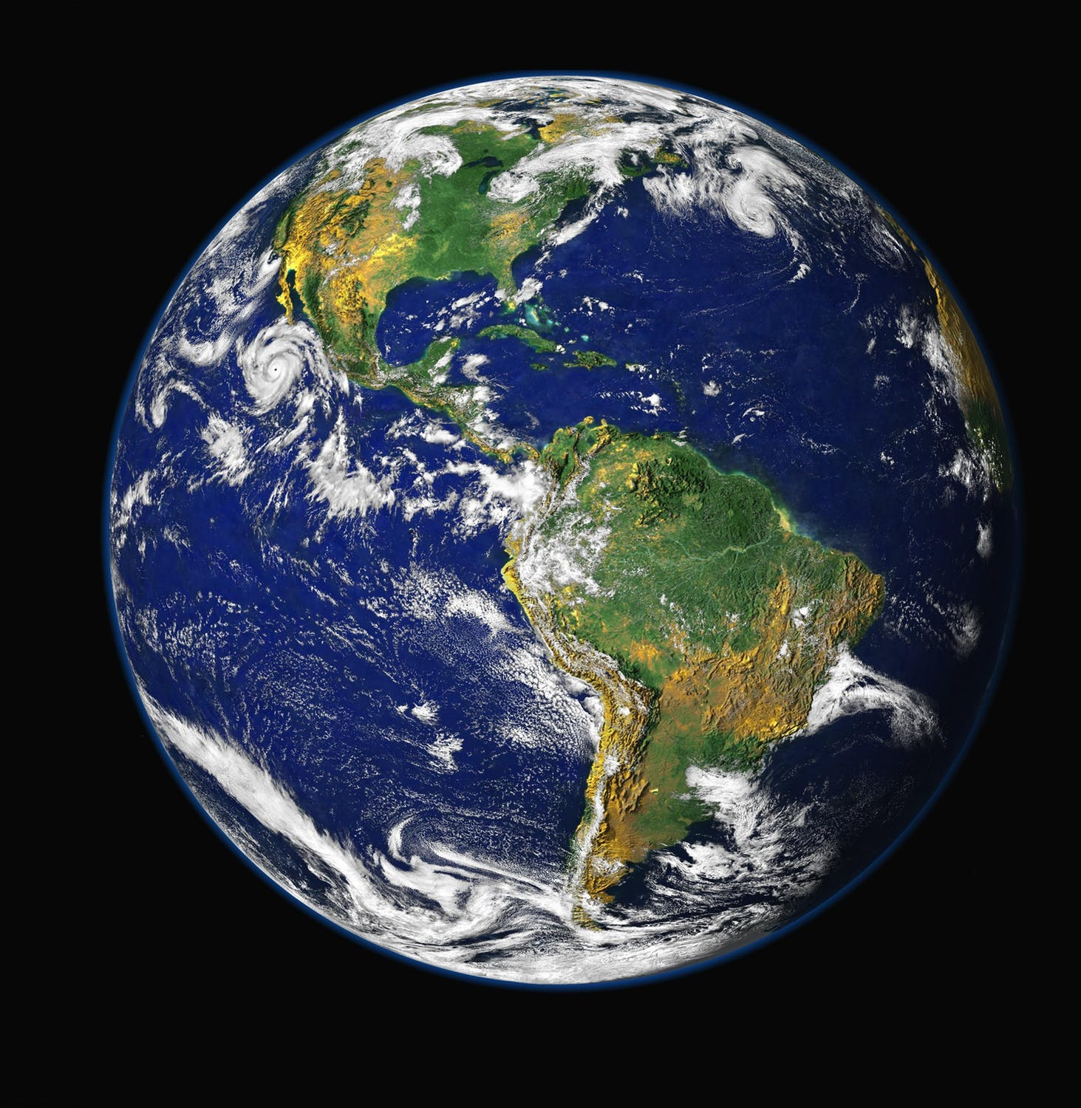
We are one humanity
From space, you can see the oceans, clouds, land masses and vegetation, but boundaries between nations.
Nothing indicates that one place is more important than another, or fundamentally different.

Slide 7
The Pale Blue Dot message:
Astronomy for environmental awareness
As seen from space, the fragility of Earth becomes evident.
It is the only planet known to harbour life and we should unite ourselves and protect the environment that we need together.

Slide 8
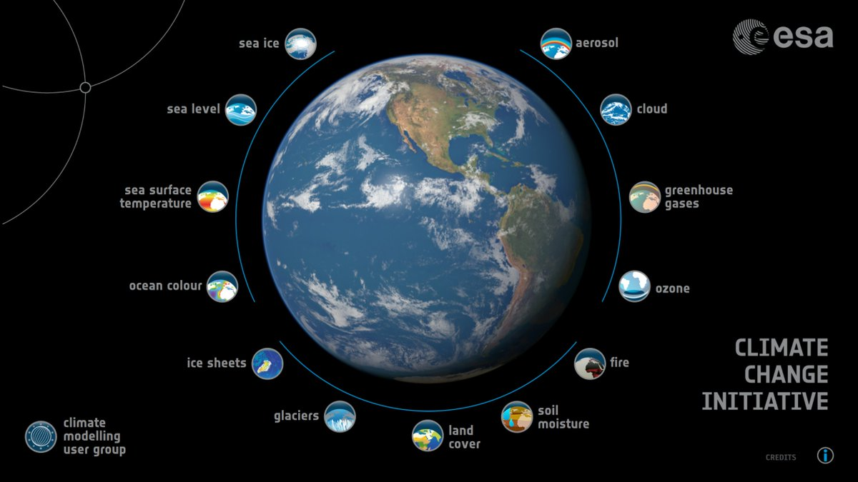
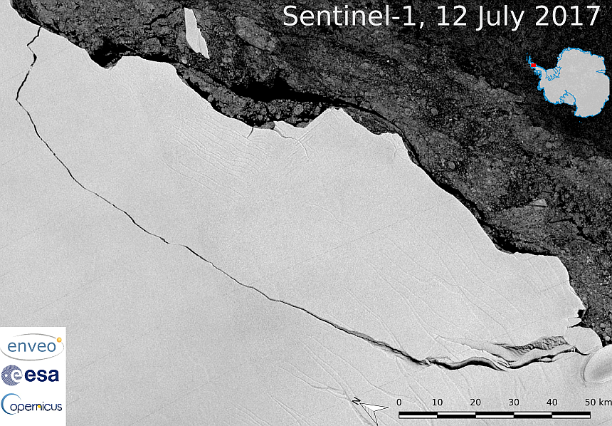
Climate change on Earth
From space, you see that there is only a thin layer of atmosphere protecting us, that natural resources are finite and that there is no other habitable planet close enough for us to reach.
Earth is our home and we need to unite to protect the environment that we can live in.

Slide 9
Events around the globe
On February 14, 2020, the Pale Blue Dot photo will celebrate its 30 year anniversary.
Evening celebration at the Carl Sagan Institute at Cornell, in the US, February 13
Pale Blue Dot symposium in the Netherlands, February 14
You can organise activities from 13-20 February

Slide 10
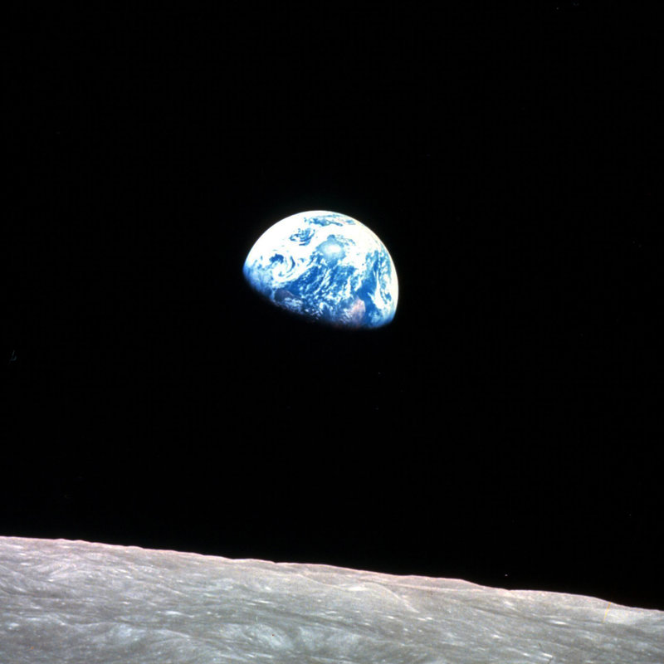
Activity idea
Organise a star party for the general public and show the movie by filmmaker Emmanuel Vaughan-Lee.
It is about the first humans who saw the Earth from the Moon and how this experience affected them.
https://www.nytimes.com/2018/10/02/opinion/earthrise-moon-space-nasa.html

Slide 11
Activity idea
Classroom activity about astronomy and global citizenship:
For students to develop an interest in other cultures and recognize similarities to other students and cultures.
http://www.astro4dev.org/science-diplomacy-through-astronomy-celebrating-our-common-humanity/more-on-the-flagship-science-diplomacy-through-astronomy-cel

Slide 12
Activity idea
Blue Marble in Empty Space school activity:
Students are taken on a virtual journey to outer space to experience that we live on a tiny planet that floats in a vast and empty space.
https://astroedu.iau.org/en/activities/1412/blue-marble-in-empty-space/

Slide 13
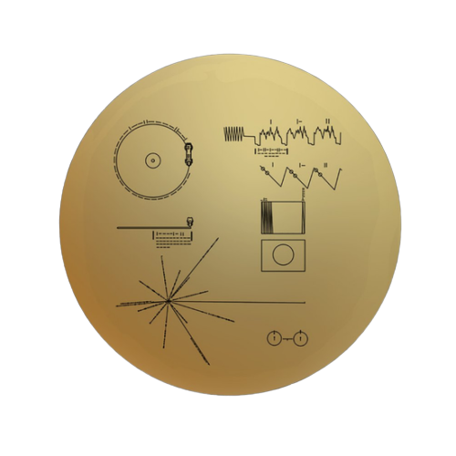
Activity idea
Golden Voyager Disk activity:
If you could send a message to the stars, what would you choose? What is important about our humankind?
https://drive.google.com/open?id=1np4z0S7RsyvTRJTrmgxeJGInRURBGBN4

Slide 14
Thank you
Contact:
IAU100 Pale Blue Dot Project Coordinator: Bethany Downer
downer@strw.leidenuniv.nl
Pale Blue Dot project: Michelle Willebrands willebrands@strw.leidenuniv.nl

